Slide 1
Overcoming Limitations of Algorithms

Slide 2
Tackling NP-Hard Problems
Two approaches to difficult combinatorial problems (NP-hard):
Use a strategy that guarantees solving problem exactly but doesn’t guarantee finding a solution in polynomial time
Use an approximation algorithm that can find an approximate (sub-optimal) solution in polynomial time

Slide 3
Exact Solution Strategies

Slide 4
Exact Solution Strategies
Exhaustive Search (Brute Force)
Useful only for small instances
Dynamic Programming
Applicable to some problems (e.g. knapsack)
Backtracking
Eliminates some unnecessary cases
Tractable for many instances – worst case still exponential
Branch-and-Bound
Refines backtracking for optimization problems

Slide 5
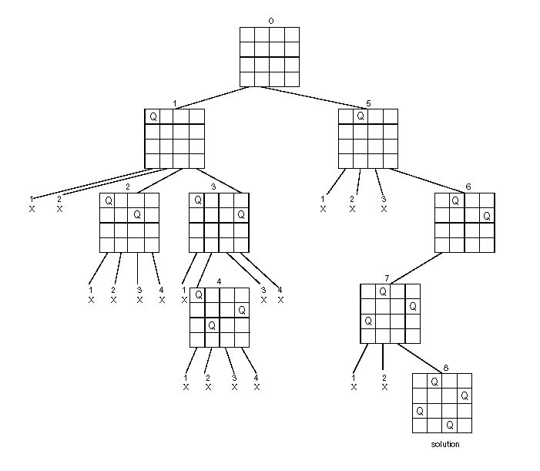
Backtracking
Construct state-space tree
Node: partial solution
Edge: choice in extending partial solution
Place n queens on an n-by-n chess board so that no two of them are in the same row, column, or diagonal

Slide 6
Backtracking
Promising Node: a partially constructed solution that can still lead to a complete solution
Nonpromising Node: partial solution that can’t lead to a complete solution.

Slide 7
Backtracking
Explore state-space using DFS.
Prune nonpromising nodes
stop exploring subtrees rooted and backtracks to such a node’s parent to continue the search
Notes:
Explores and prunes for n-queens

Slide 8
Subset-Sum Problem
Find a subset of a given set, e.g. A = {3,5,6,7} whose sum is equal to given value, e.g. d = 15.
Convenient to presort set
Notes:
Branches represent including or excluding a value – stop exploring when sum exceeds d.

Slide 9
Backtracking
Can run out of memory or time when solving a problem
Hope that will prune enough
Tricks to improve pruning
Can exploit symmetry in combinatorial problems, e.g. city c before d in TSP.
Preassign values, e.g. starting TSP at node a.
Presorting values to explore
Notes:
Exhaustive Search – slow for all instances, Backtracking feasible for some. Even if no pruning, still provides systematic exploration.

Slide 10
Branch-and-Bound

Slide 11
Branch-and-Bound
Branch-and-Bound: an enhancement of backtracking
Only applicable to optimization problems
For each node of state-space tree, computes a bound on the value of the objective function for all descendants of the node (extensions of the partial solution)

Slide 12
Branch-and-Bound
Uses the bound for:
Ruling out nodes as “nonpromising” – if bound is not better than the best solution seen so far
Neither this node nor any below it can be optimal
Backtracking only cuts off infeasible branches
Guiding search through state-space

Slide 13
Assignment Problem
Select one element in each row of cost matrix such that:
No two selected elements in the same column
Sum is minimized
 | Job 1 | Job 2 | Job 3 | Job 4
Person a | 9 | 2 | 7 | 8
Person b | 6 | 4 | 3 | 7
Person c | 5 | 8 | 1 | 8
Person d | 7 | 6 | 9 | 4

Slide 14
Assignment Problem
 | Job 1 | Job 2 | Job 3 | Job 4
Person a | 9 | 2 | 7 | 8
Person b | 6 | 4 | 3 | 7
Person c | 5 | 8 | 1 | 8
Person d | 7 | 6 | 9 | 4
Lower bound – optimal solution must be at least sum of smallest elems in each row: 2 + 4 + 1 + 4 = 10 or cols: 5 + 2 + 1 + 4 = 12

Slide 15
Assignment Problem
 | Job 1 | Job 2 | Job 3 | Job 4
Person a | 9 | 2 | 7 | 8
Person b | 6 | 4 | 3 | 7
Person c | 5 | 8 | 1 | 8
Person d | 7 | 6 | 9 | 4
Same applies to partial solution, e.g. (a,1) – doesn’t have to represent legitimate soln: 9 + 3 + 1 + 4 = 17

Slide 16
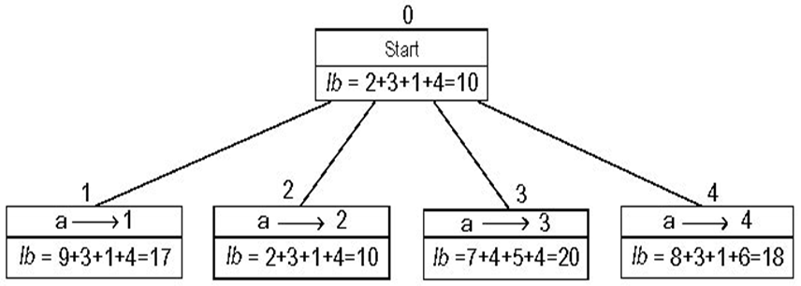
Assignment Problem
Rather than 1 child of last promising node, generate all children of most promising node among live (non-terminated) leaves.

Slide 17
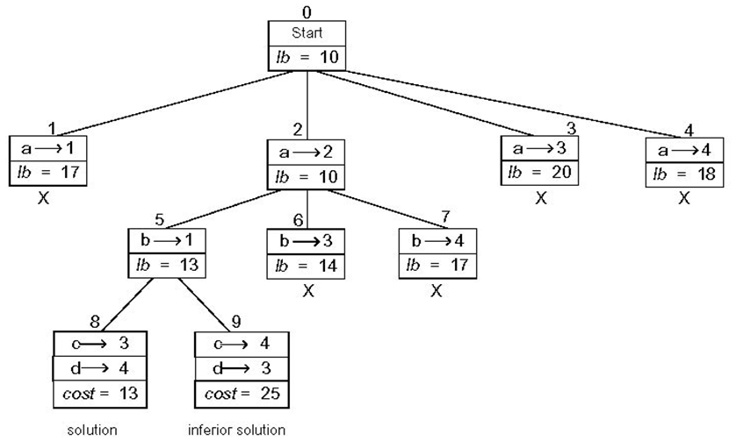
Best-First Branch-and-Bound
Notes:
Leaves terminated because worse than found solution.

Slide 18
Traveling Salesman Problem
Need to define a lower bound
Smallest intercity distance * number of cities left
For every city, sum up two shortest links connecting to city, divide by 2 and take ceiling.
Must take different path in and out of each city
Consider tours starting at particular city, e.g. a, and in which city b occurs before c.

Slide 19
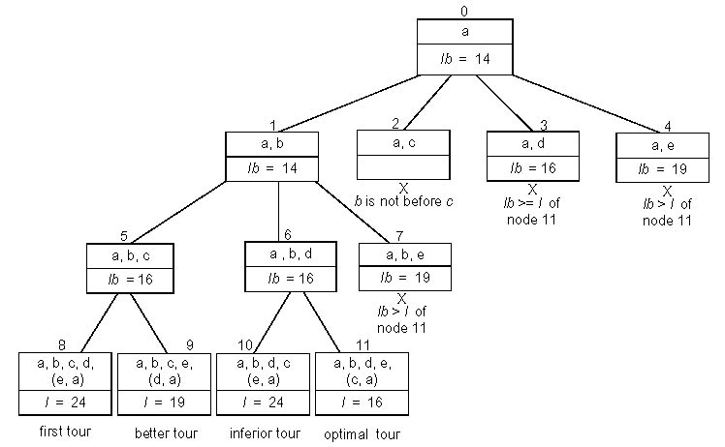
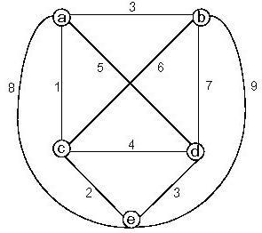
TSP

Slide 20
Branch-and-Bound
Similar to backtracking – can run out of memory or time when solving a problem
Can solve many instances of combinatorial problems – impossible to predict which ones solvable
Same tricks to improve pruning can be used
Good bounding function may be hard to find
AI looks at alternatives to best-first

Slide 21
Approximation Approach

Slide 22
Approximation Approach
For some instances of NP-hard problems, can use branch-and-bound or DP
Or polynomial-time approximation algorithm to get non-optimal solution (hope close)
Particularly sensible if data noisy
Some problems have special classes of instances that are easier to solve than general case

Slide 23
Approximation Accuracy
Want to measure accuracy:
Accuracy Ratio: r(s_{a}) = f(s*) / f(s_{a}) for maximization problems
f(s_{a}) and f(s*): values of the objective function f for the approximate solution s_{a} and actual optimal solution s*
Value closer to 1 is ideal
Notes:
r(s_{a}) = f(s_{a}) / f(s*) for minimization problems

Slide 24
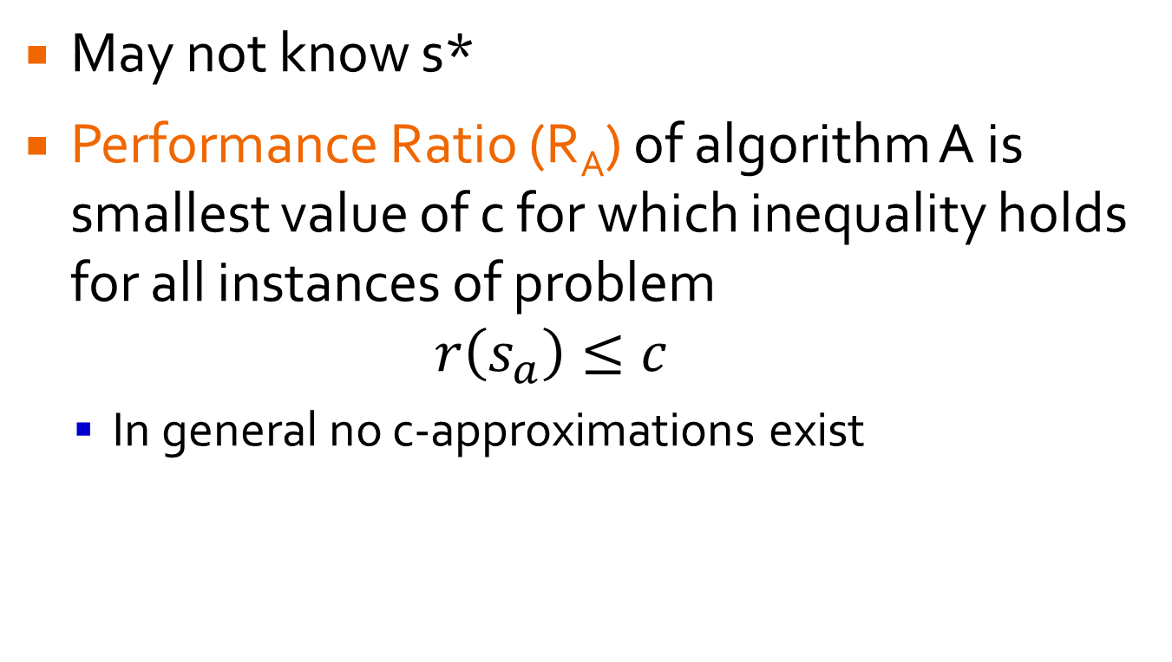
Approximation Accuracy
May not know s*
Performance Ratio (R_{A}) of algorithm A is smallest value of c for which inequality holds for all instances of problem $r\left(s_{a}\right)≤c$
In general no c-approximations exist
Notes:
Want close to 1

Slide 25
Heuristics for TSP
Greedy Approaches:
Nearest Neighbor
Multifragment
Minimum Spanning Tree Approaches:
Twice-Around-the-Tree

Slide 26
Nearest Neighbor
Always go to nearest unvisited city – then return to start city.
Tour may vary depending on start city
1
A
B
s_{a} : A – B – C – D – A of length 10
s* : A – B – D – C – A of length 8
What is accuracy ratio of s_{a}?
6
2
3
3
D
C
1
Notes:
Ties broken arbitrarily

Slide 27

Nearest Neighbor
Always go to nearest unvisited city – then return to start city.
Tour may vary depending on start city
1
A
B
$$r\left(s_{a}\right)=\frac{f\left(s_{a}\right)}{f\left(s^{∗}\right)}=\frac{10}{8}=1.25$$
Tour s_{a} is 25% longer than optimal.
In general, edge traversed by s_{a} but not s* could be arbitrarily large, so $R_{A}=∞$
6
2
3
3
D
C
1
Notes:
Simple but not accurate

Slide 28
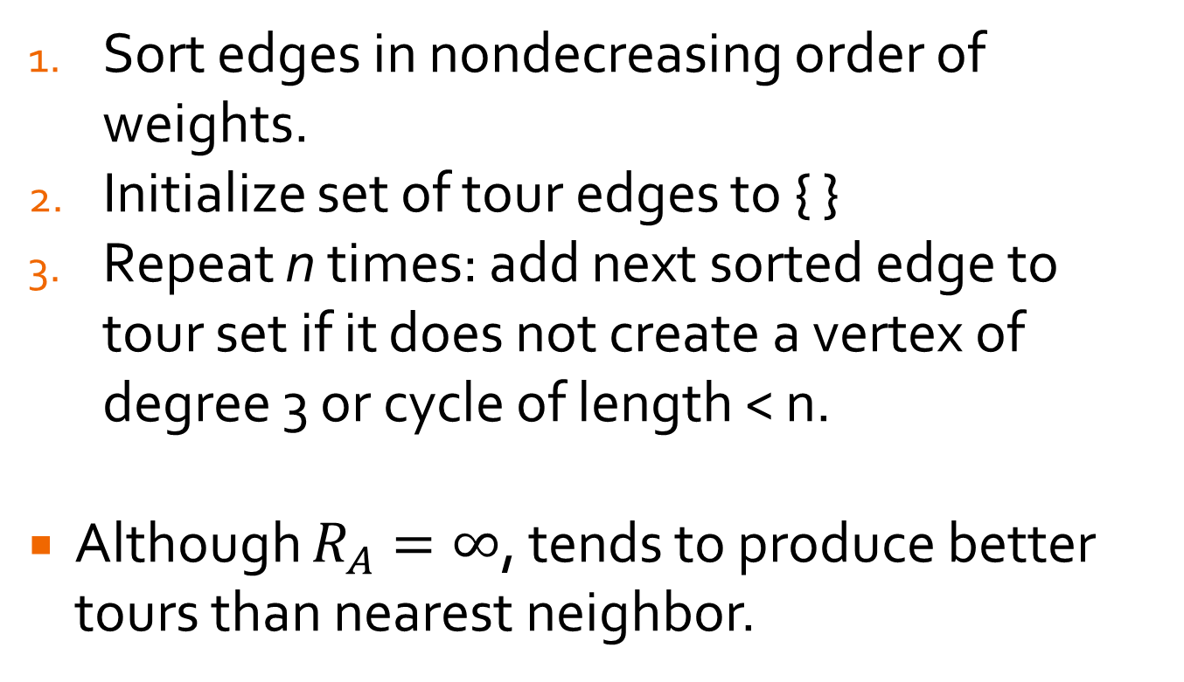
Multifragment Heuristic Algorithm
Sort edges in nondecreasing order of weights.
Initialize set of tour edges to { }
Repeat n times: add next sorted edge to tour set if it does not create a vertex of degree 3 or cycle of length < n.
Although $R_{A}=∞$, tends to produce better tours than nearest neighbor.

Slide 29
Multifragment Heuristic Algorithm
Sorted Edges = (A,B) (C,D) (B,C) (A,C) (B,D) (A,D)
Tour Edges = {}
What edges would be added to tour?
1
A
B
6
2
3
3
D
C
1

Slide 30
Multifragment Heuristic Algorithm
Sorted Edges = (A,C) (B,D) (A,D)
Tour Edges = {(A,B) (C,D) (B,C)}
1
A
B
6
2
3
3
D
C
1

Slide 31
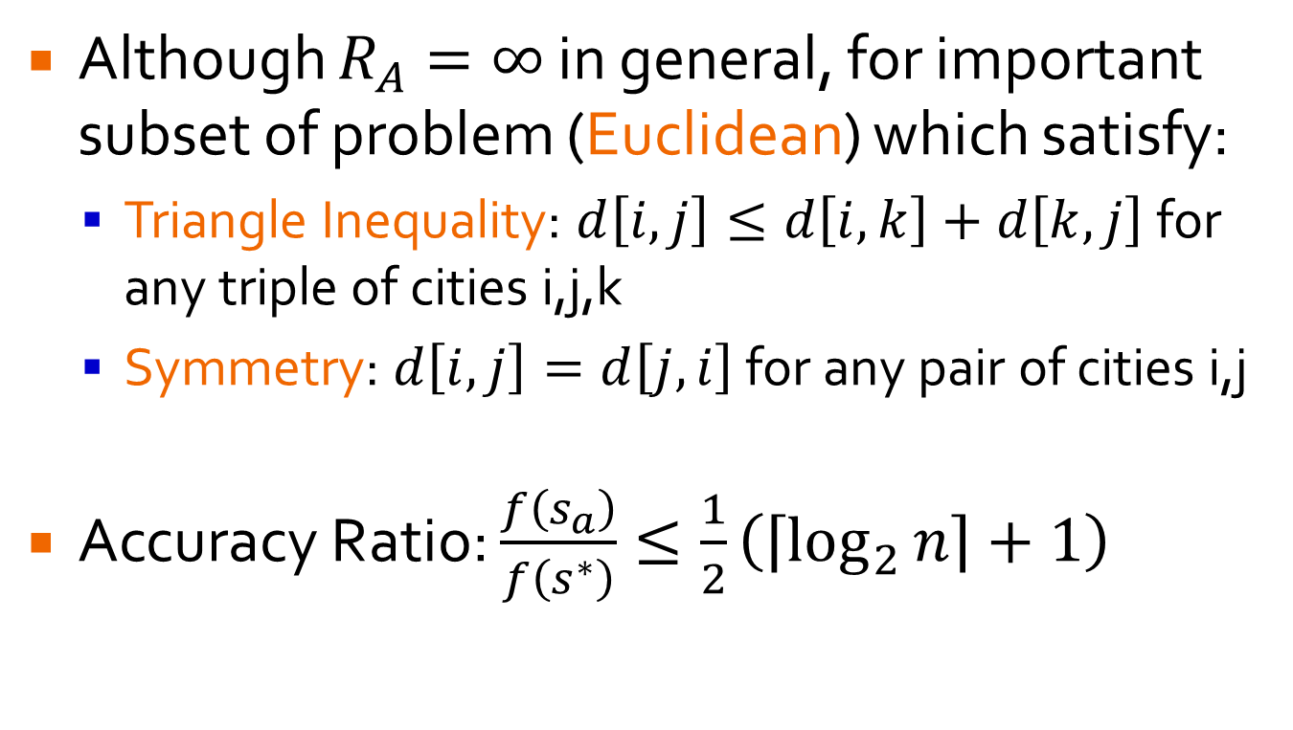
Greedy Approaches to TSP
Although $R_{A}=∞$ in general, for important subset of problem (Euclidean) which satisfy:
Triangle Inequality: $d\left[i,j\right]≤d\left[i,k\right]+d\left[k,j\right]$for any triple of cities i,j,k
Symmetry: $d\left[i,j\right]=d\left[j,i\right]$ for any pair of cities i,j
Accuracy Ratio: $\frac{f\left(s_{a}\right)}{f\left(s^{∗}\right)}≤\frac{1}{2}\left(\left\lceil \log_{2}{n}\right\rceil +1\right)$
Notes:
Many real-world applications are Euclidean – but not airline tickets!

Slide 32
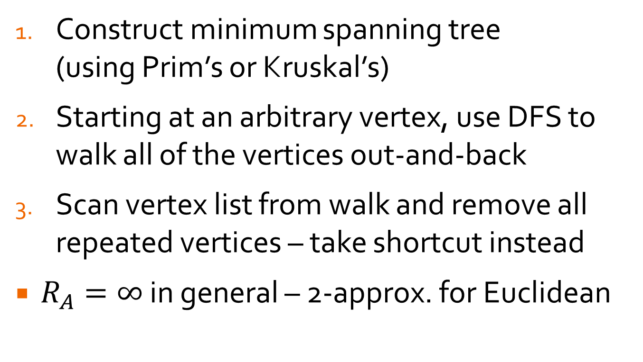
Twice-Around-the-Tree
Construct minimum spanning tree (using Prim’s or Kruskal’s)
Starting at an arbitrary vertex, use DFS to walk all of the vertices out-and-back
Scan vertex list from walk and remove all repeated vertices – take shortcut instead
$R_{A}=∞$ in general – 2-approx. for Euclidean
Notes:
In Euclidean graph, taking shortcut cannot increase tour length

Slide 33
Twice-Around-the-Tree
Walk: a – b – c – b – d – e – d – b – a Tour: a – b – c – d – e – a

Slide 34
Lab
Work on HW 5

